Slide 1
Mass Movement
Chapter
8
Learning outcomes: 1.3

Slide 2
At the end of this chapter, you will be able to:
8.1 Describe and explain the factors affecting mass movement.
8.2 Explain the causes and effects of different types of mass movements.
8.3 Describe how to prevent mass movements.
8.4 Discuss how to act sustainably with regard to mass movements.

Slide 3
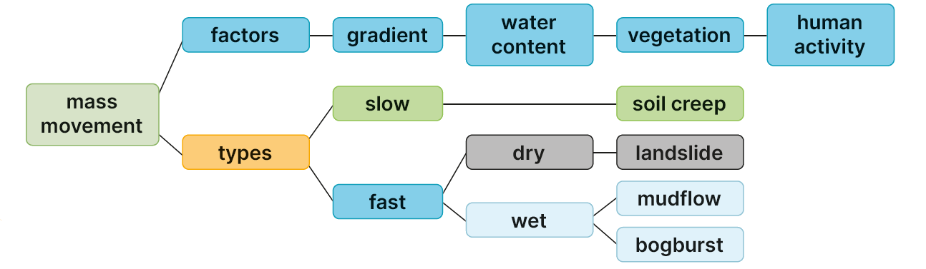
Keyword connections

Slide 4
8.1 Describe and explain the factors affecting mass movement.
Mass movement is the movement of loose, weathered material called scree (or regolith) downslope under the influence of gravity. It can occur rapidly or slowly. Mass movement can be wet or dry.
Factors affecting mass movement
Factors are the things that influence something else.
Factors affecting mass movement include:
Water content
Vegetation
Gradient
Human activity.

Slide 5
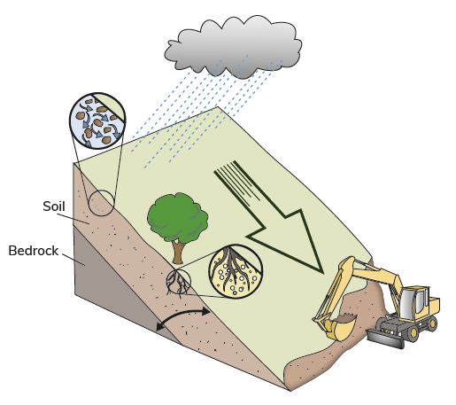
8.1 Describe and explain the factors affecting mass movement.
Water content
A higher water content makes the scree (or regolith) heavier and acts as a lubricant. Soil particles separate and move downhill more easily.
Vegetation
The roots of plants bind soil particles together and help prevent mass movement. If vegetation such as trees is removed from a slope, the soil particles are free to move easily.
Gradient
The gradient of the slope is how steep it is. Soil and rocks move very quickly on a steep slope. On more gentle slopes, soil and rocks move very slowly.
Human activity
If humans undermine the base of a slope by undercutting, the slope becomes unstable and can collapse, causing mass movement.

Slide 6
8.1 Describe and explain the factors affecting mass movement.
Go to Section 8.1 on page 30 of your Skills Book.

Slide 7
8.2 Explain the causes and effects of different types of mass movements.
Different types of mass movement
Type of movement | Slope gradient | Wet/dry | Speed
Soil creep | Gentle | Dry | Slow
Landslide | Steep | Dry | Rapid
Bogburst | Gentle to steep | Wet | Fast
Mudflow | Gentle to steep | Wet | Very rapid

Slide 8
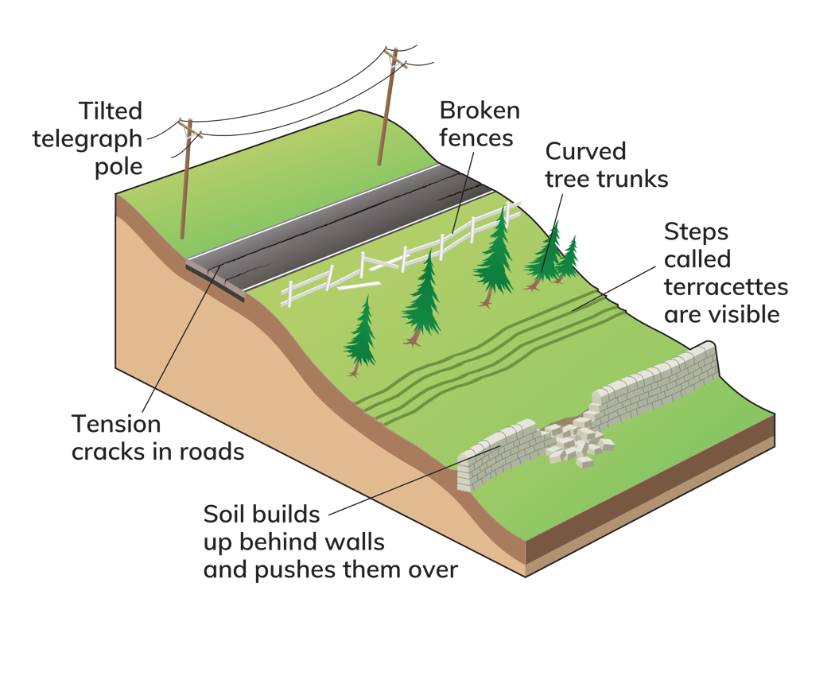
8.2 Explain the causes and effects of different types of mass movements.
Slow Mass Movement: Soil Creep
Slow movement of soil downslope
Slowest type of mass movement
Up to 1 cm per year
Cannot see it as it happens.
You can only see evidence of soil creep. Anything located near the top of the soil will get gradually pushed over.

Slide 9
8.2 Explain the causes and effects of different types of mass movements.
Fast Mass Movement: Bogburst
A bogburst occurs when peat becomes saturated with rainwater.
Bogbursts occur in upland areas where wet and heavy peat moves quickly downslope.
The moving peat can destroy everything in its path.
Activity
Complete the Exam Expert activity on page 81 of your Textbook.

Slide 10
8.2 Explain the causes and effects of different types of mass movements.
Rapid Mass Movement: Landslide
Landslides are fast mass movements.
Landslides can have several causes, including human activity, deforestation and earthquakes.
Activity
Complete the Exam Expert activity on page 82 of your Textbook.

Slide 11
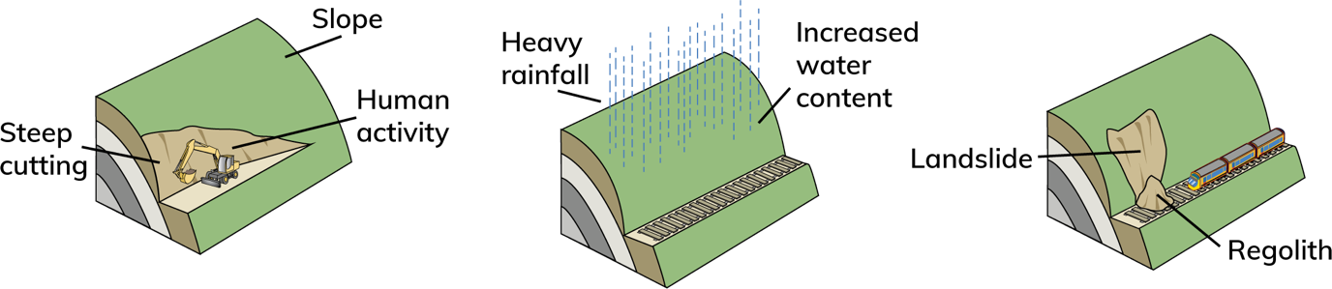
8.2 Explain the causes and effects of different types of mass movements.
Human activity and landslides
Human activity can cause landslides.
One example of this is when the base of a slope is cut away in order to make space for a road or railway.
The slope may become unstable because the base of the slope is no longer there to support it.

Slide 12
8.2 Explain the causes and effects of different types of mass movements.
Fast Mass Movement: Mudflow
Mudflows occur when soil is saturated with water following heavy rainfall.
The soil and water mix to form mud, which moves rapidly downslope.
Mudflows can also occur following volcanic activity when snow on a mountain melts and mixes with soil and volcanic ash.
This type of mudflow is called a lahar.
Activity
Complete the Exam Expert activity on page 83 of your Textbook.

Slide 13
8.2 Explain the causes and effects of different types of mass movements.
Go to Section 8.2 on page 30 of your Skills Book.

Slide 14
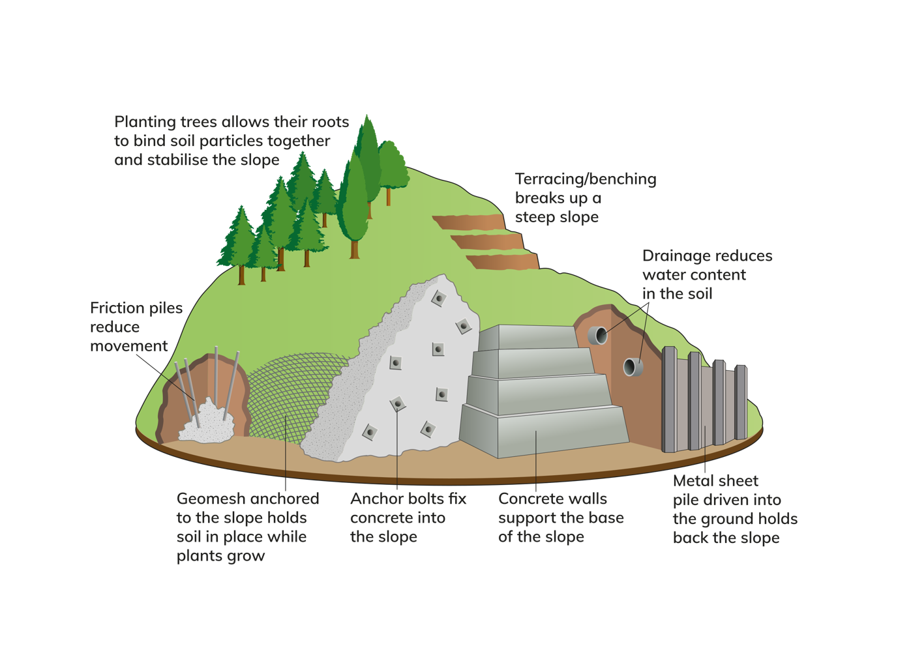
8.3 Describe how to prevent mass movements.

Slide 15
8.3 Describe how to prevent mass movements.
Go to Section 8.3 on page 32 of your Skills Book.

Slide 16
8.4 Discuss how to act sustainably with regard to mass movements.
Mass movement affects people and property.
We need to manage slopes sustainably in order to reduce mass movement.
Climate change will lead to increased and heavier rainfall in some locations.
Higher levels of water content make mass movements more likely.
Combatting climate change will help reduce mass movements and their impact.
Deforestation – cutting down trees (for example, in Brazil) – also causes mass movement.
Governments must find a balance between the need to provide land to people and the need to protect the environment.

Slide 17
8.3 Describe how to prevent mass movements.
Go to Section 8.4 on page 32 of your Skills Book.

Slide 18
Class Debate
The Brazilian government has allowed people to clear forests in the Amazon for settlement and farming.
Deforestation causes mass movements and adds to climate change.
Discuss this in class. Can we balance these two issues?

Slide 19
Assess your progress
Go to page 33 of your Skills Book and assess your progress.
8.1 Describe and explain the factors affecting mass movement.
8.2 Explain the causes and effects of different types of mass movements.
8.3 Describe how to prevent mass movements.
8.4 Discuss how to act sustainably with regard to mass movements.
Identify any gaps in your learning. Use the Rapid Revision on page 85 of your Textbook to jog your memory.

